Slide 1
Beginning Software Craftsmanship
Brendan Enrick | @Brendoneus
Jeff Valore | @CodingWithSpike

Slide 2
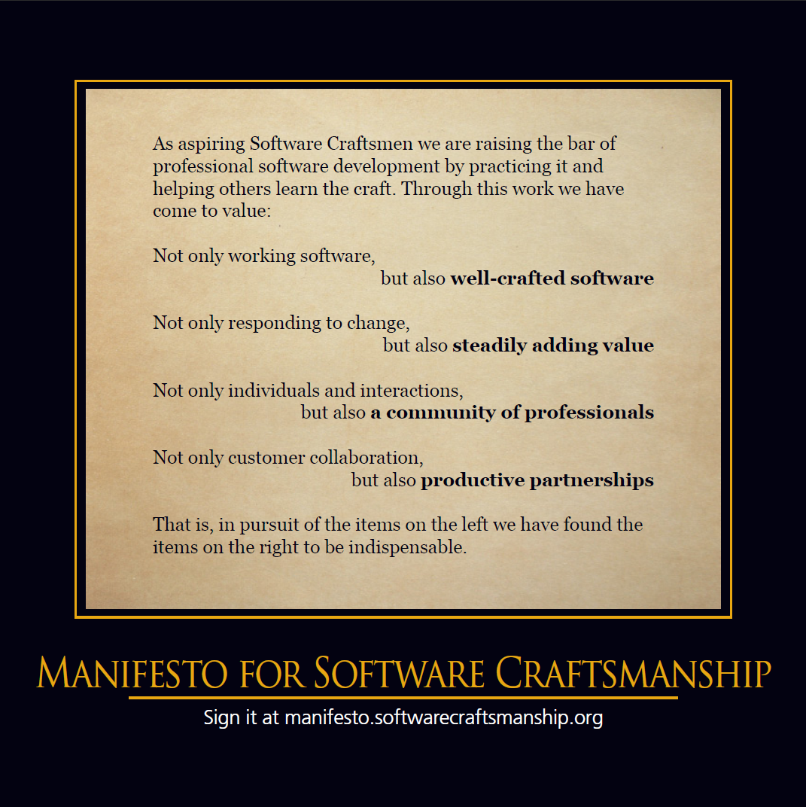

Slide 3
Software Craftsmanship TL;DR
Agile++

Slide 4
Software Craftsmanship TL;DR
Practice, teach, and learn so that we can steadily add value to well-crafted software, promote a strong community of professionals, and partner closely with others.

Slide 5
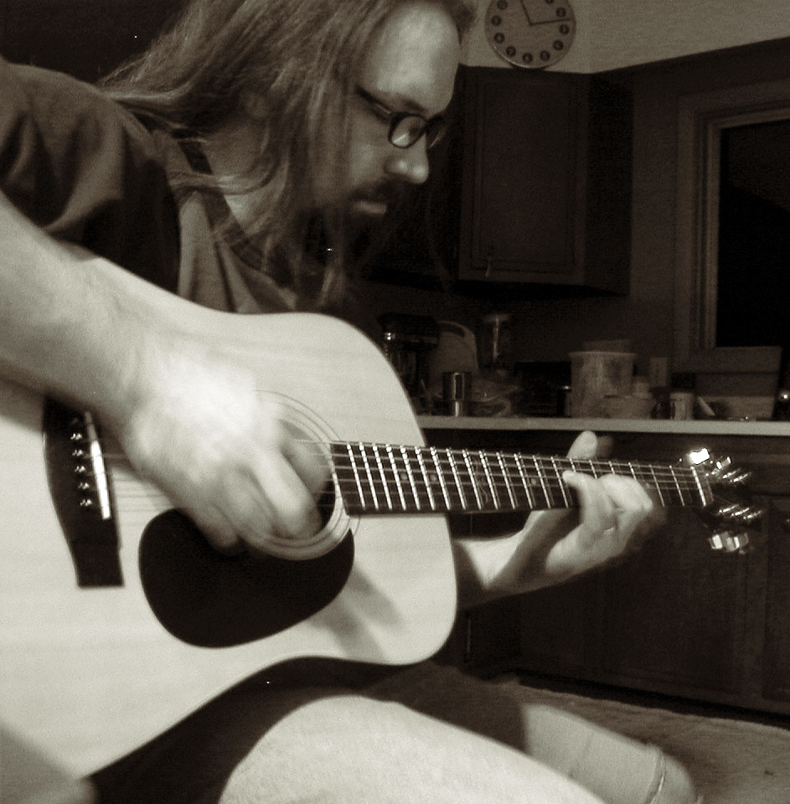
Why Practice?
Notes:
<div xmlns:cc="http://creativecommons.org/ns#" about="http://www.flickr.com/photos/usonian/130586983/"><a rel="cc:attributionURL" href="http://www.flickr.com/photos/usonian/">http://www.flickr.com/photos/usonian/</a> / <a rel="license" href="http://creativecommons.org/licenses/by-nc-sa/2.0/">CC BY-NC-SA 2.0</a></div>

Slide 6
Hey! I know how to code. I don’t need to practice.

Slide 7
Hey! I already practice. I write code daily.

Slide 8
Practice (learning method)
Practice is the act of rehearsing a behavior over and over, or engaging in an activity again and again, for the purpose of improving or mastering it, as in the phrase "practice makes perfect".
http://en.wikipedia.org/wiki/Practice_(learning_method) 17 October 2012

Slide 9
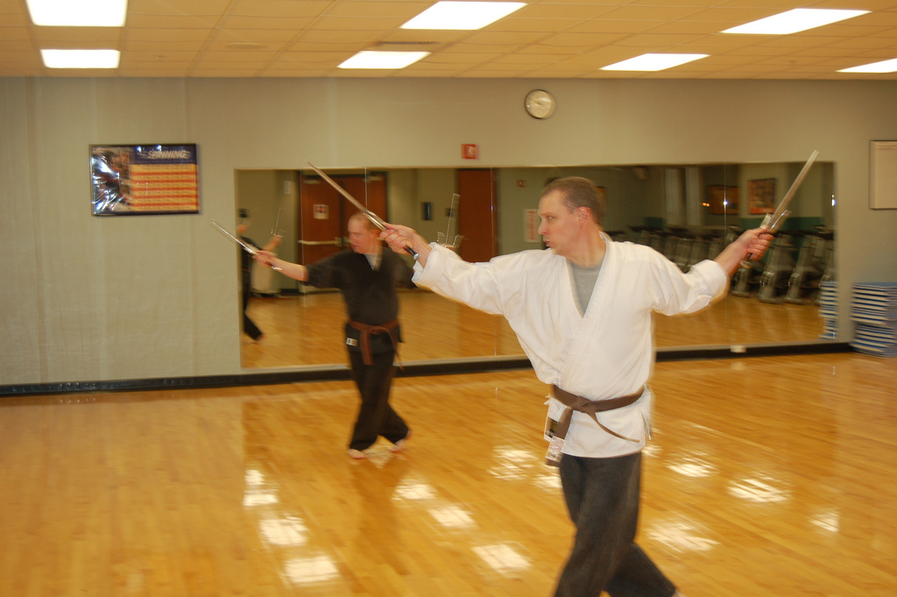
Katas

Slide 10
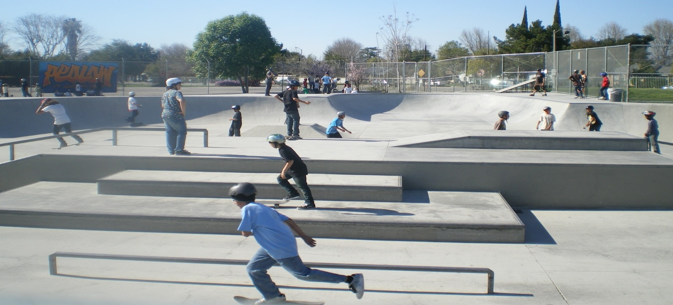
Exercises

Slide 11

Stretch

Slide 12

Grow

Slide 13
How to Practice
Pair Programming
Trying new things
Get out of your comfort zone
Repetition, repetition, and repetition.

Slide 14
Where do I learn more?
http://HudsonSC.com
http://softwarecraftsmanship.org
http://groups.softwarecraftsmanship.org
http://ProjectEuler.net
http://CodingDojo.org
http://codekata.pragprog.com

Slide 15
Speaker Contact Info
Brendan Enrick
Brendan.Enrick.com
@BRENDONEUS
Jeff Valore
@CodingWithSpike
Slides will be posted on:
http://Brendan.Enrick.com/
https://github.com/TechConf/CodeMash2015
http://HudsonSC.com/

